Slide 1

Learning a new language?

Slide 2



Difficulty in speaking and understanding foreign languages.
Users are given the opportunity spend few minutes of their day to practice a new language for free.

Slide 4


A public E-learning company.
Founded - 2011
Launched to public - 2012
Headquarters – Pittsburgh, Pennsylvania, US
CEO – Luis Von Ahn

Slide 5

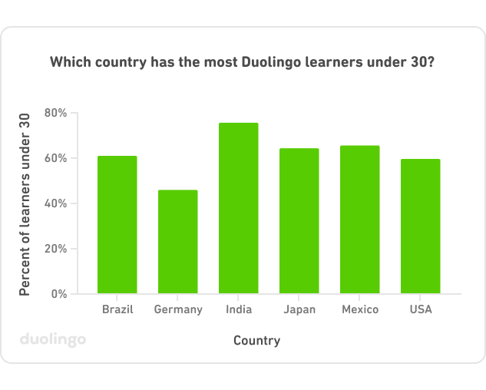

Over 500 million downloads.
Over 88.4 million registered users.
42 different languages with over 100 courses.
Revenue grew 45% in the last quarter.
Regular income from subscriptions (12%).

Slide 6

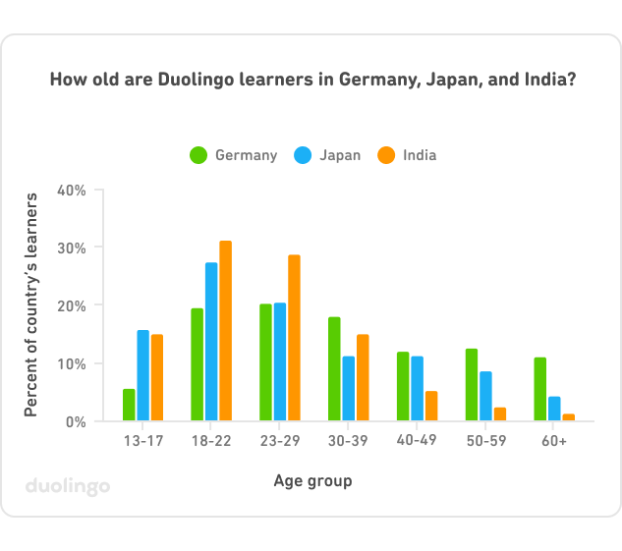

Individuals who are interested in learning a new language for free.

Slide 7

Duolingo | LingoDeer
Vast selection of languages to select from | Less languages to select from
 | Good for Asian languages
More user friendly layout
Expands focus to oral activities | Not focused on oral activities
Premium version $6.99 | Premium version $11.99

Slide 8


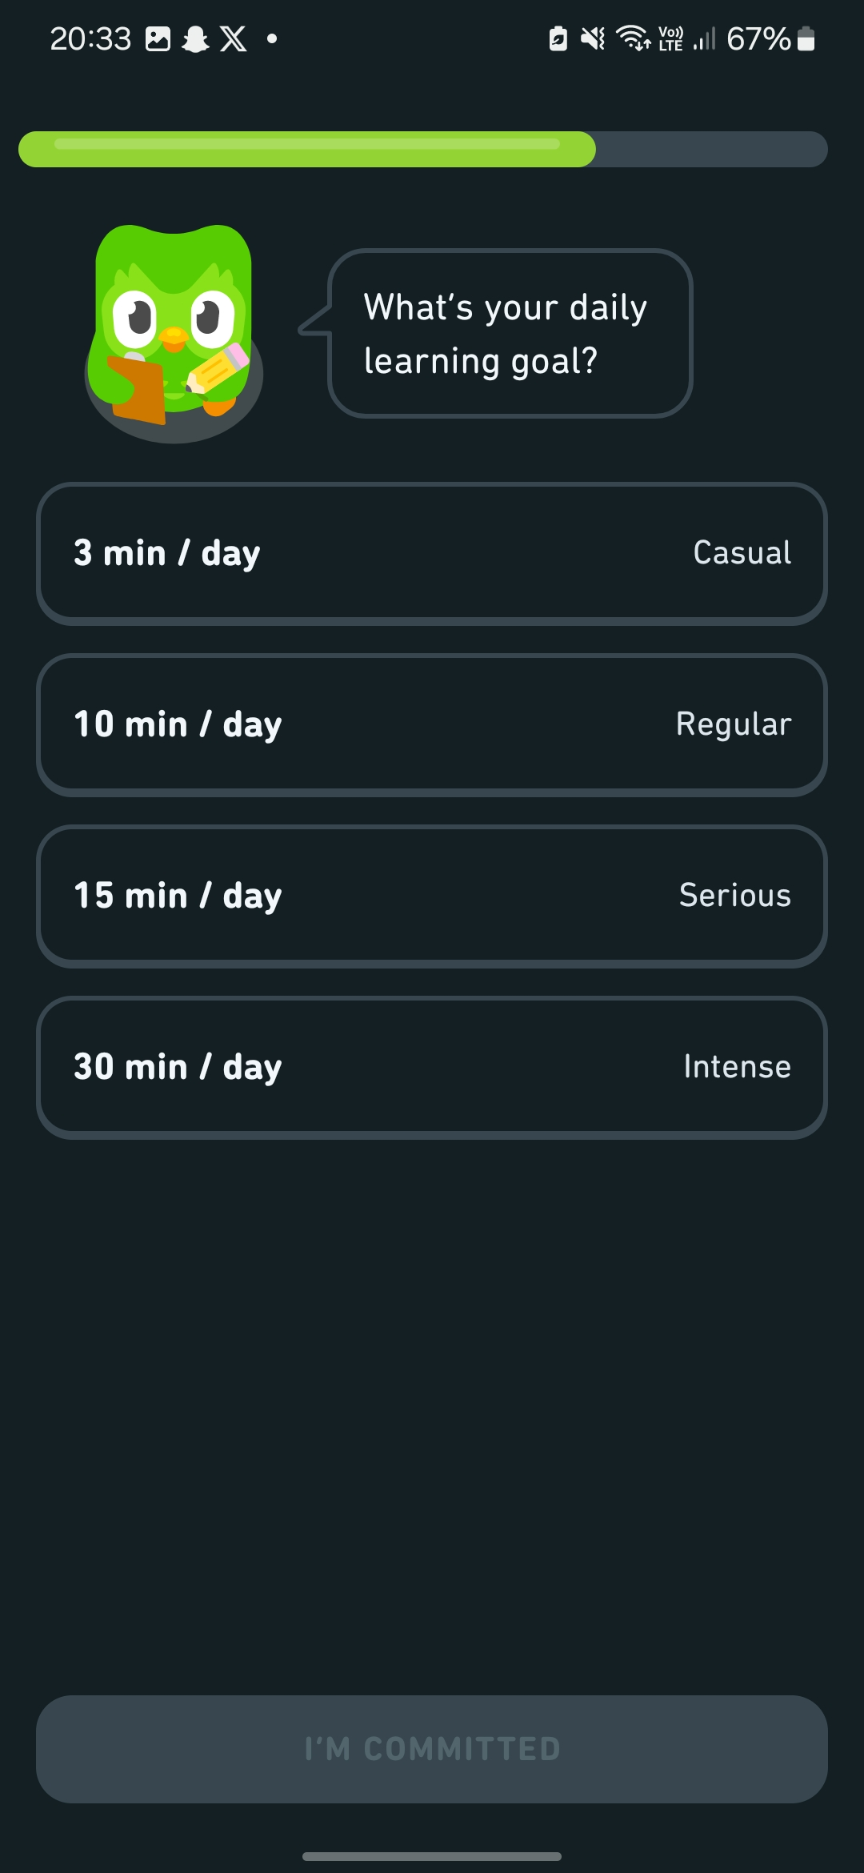
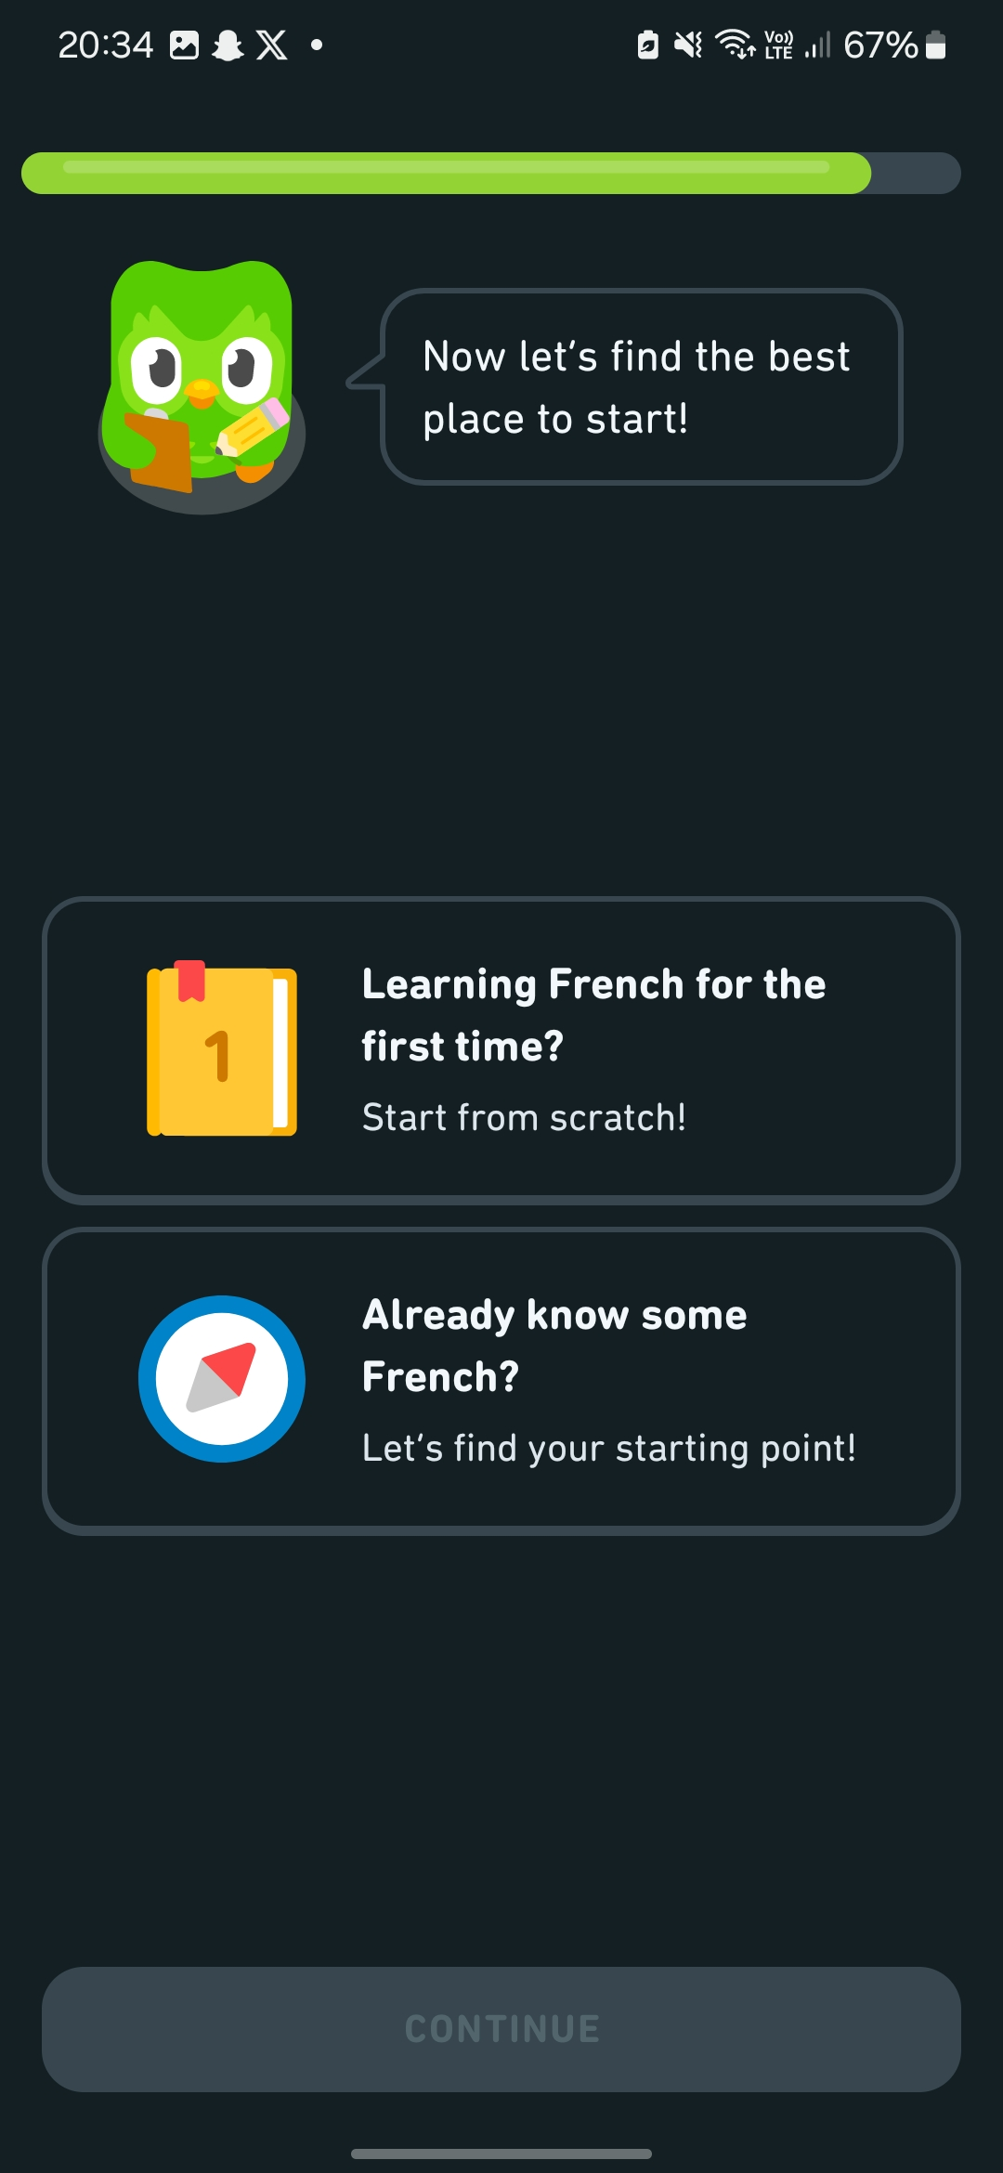

Gamification
Bite-sized lessons
Adaptive learning

Slide 9


Is currently less focused on grammar.
Some scenarios brought out are not realistic
Hire more skilled educators for grammar.
Pay more attention to details to provide a more realistic experience for the user.

Slide 10


“…using Duolingo application has a significant effect on students’ vocabulary mastery.”
-ELTR Journal (July 2020)
(English Teaching and Researching Journal)

Slide 11







duolingo.com
@duolingo
@duolingo
@duolingo
@duolingo

